Slide 1
Summarising- Liveability
Yr 7 Geography 2020

Slide 2
Liveability – write down the definition
The term ‘liveability’ is used to describe how suitable or good a place is to live in.
If a place is very ‘liveable’, the people that live their have a high quality of life.
Quality of life = the standard of health, comfort and happiness that people have.
To tell how liveable a place is, we look at things like: environmental quality, safety, education, healthcare etc.

Slide 3
Liveable cities
Can you remember the top 3 liveable cities from yesterday’s lesson?

Slide 4

Revision: What is a summary?
A summary is a short version of a text that only includes the most important points. It means you sum up what you have read.
S- Shorter than the original
U- Using own words
M- Main points only

Slide 5
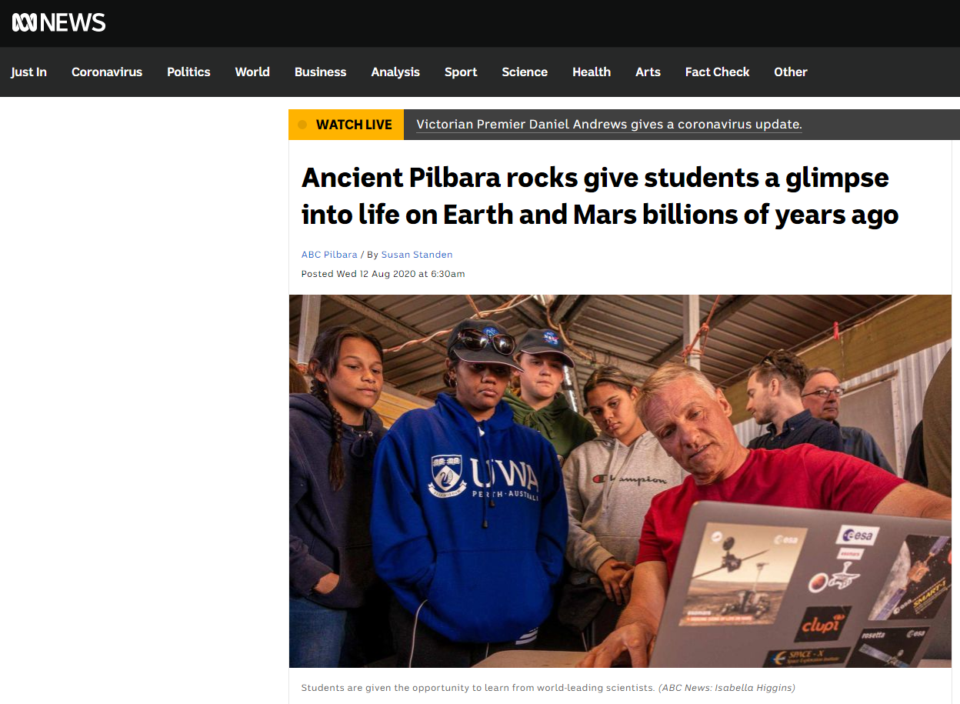
1. Before
*What do you think this text will be about?
Before reading the text, predict what it will be about. You can do this by looking at:
Title
Diagrams
Maps
Pictures
Symbols
Underlined words
Numbers
Standen, S. (2020, Aug 12). Ancient Pilbara rocks give students a glimpse into life on Earth and Mars billions of years ago. ABC News. Retrieved from
https://www.abc.net.au/news

Slide 6
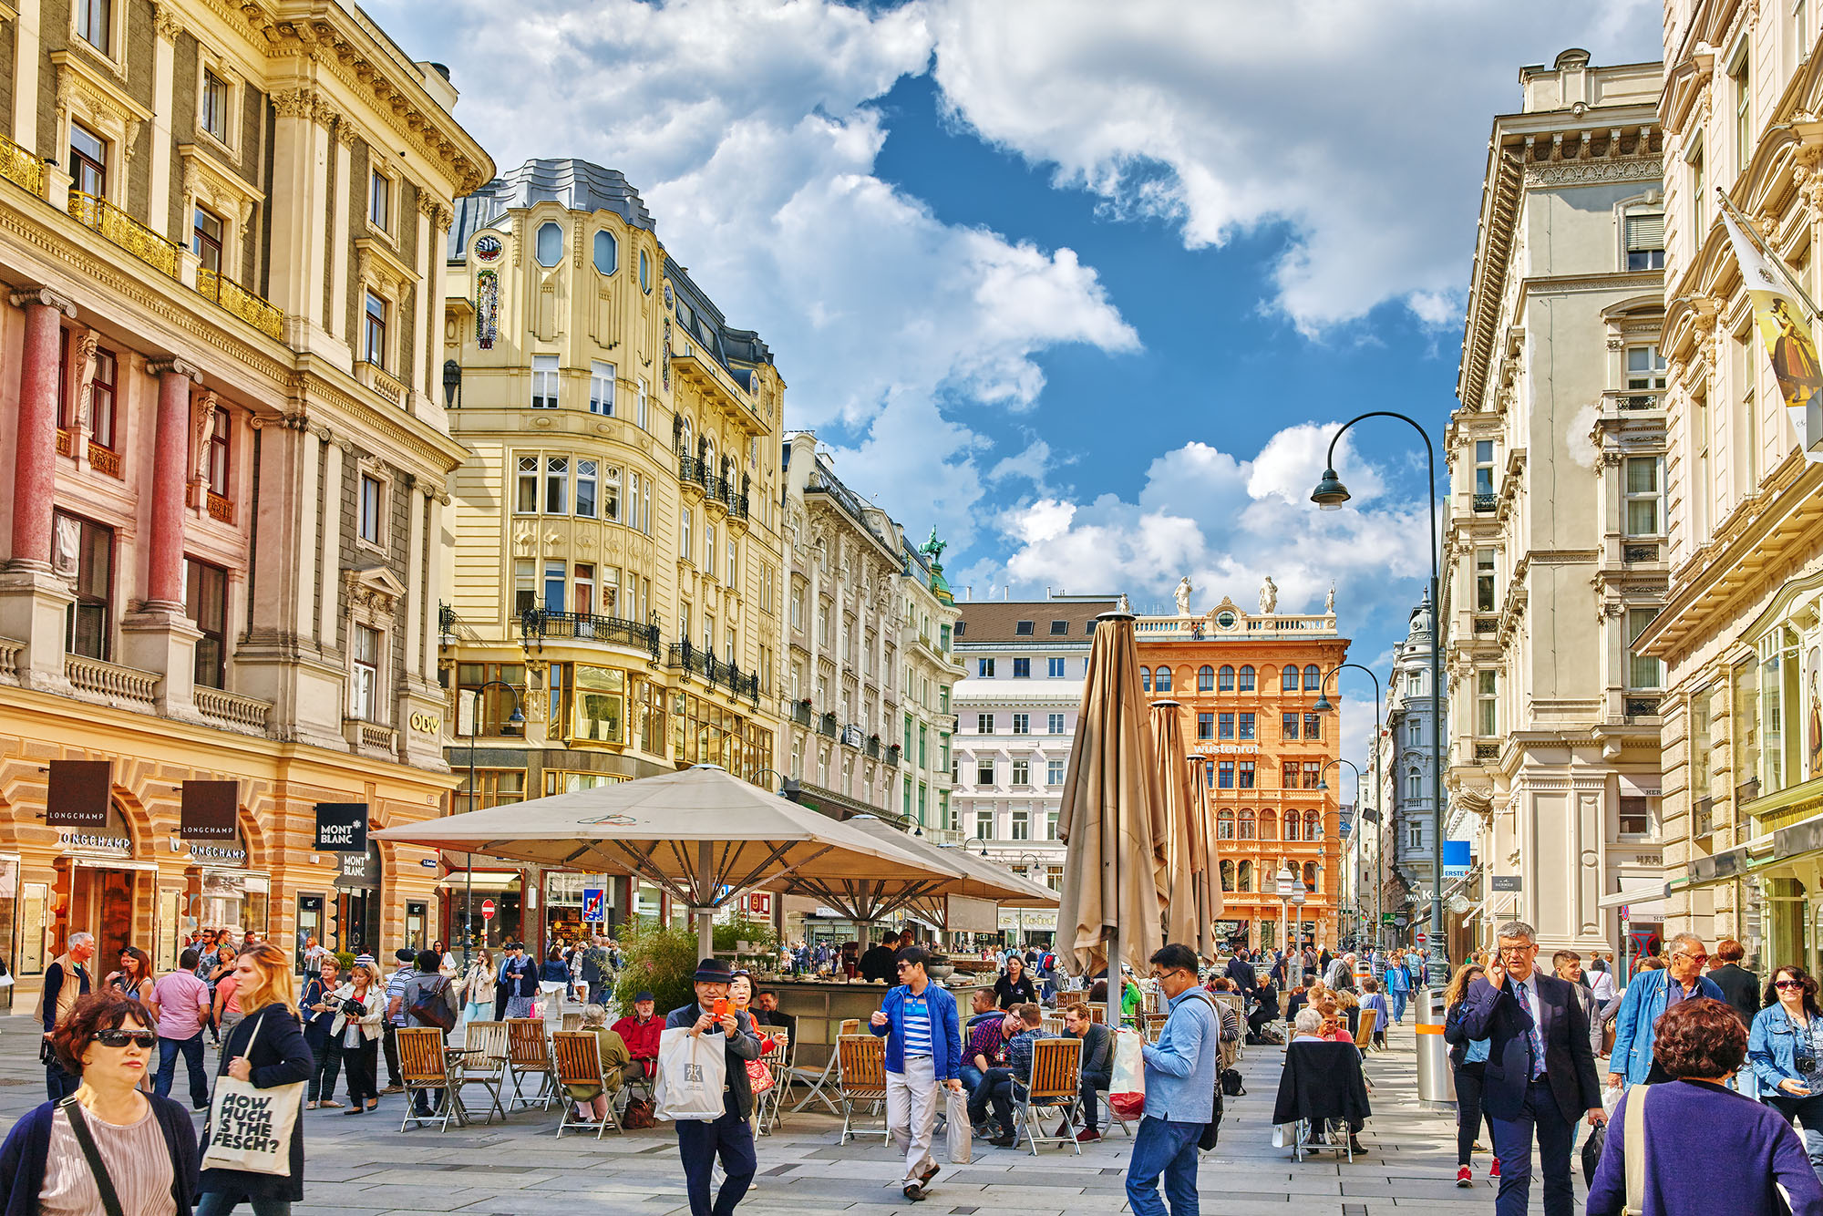
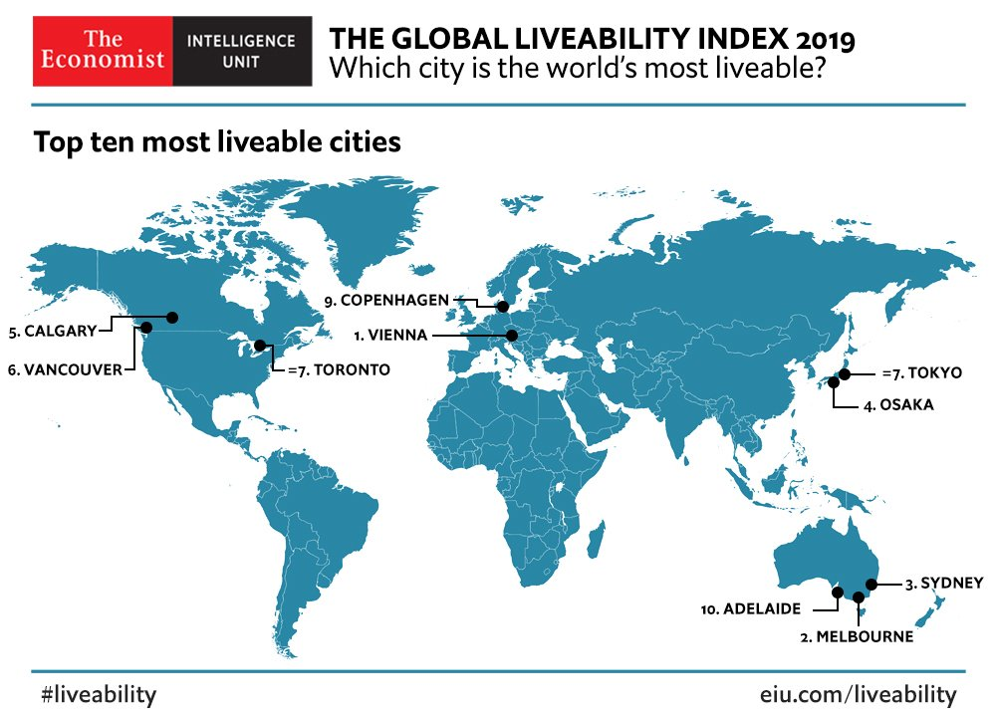
Use the text features to predict what it will be about:
Vienna remains the world’s most liveable city
The Economist, Sep 4th, 2019
Vienna prides itself on its music and art, its grand architecture and its café’s. The city also has affordable housing, plenty of green spaces and a top public transport system. According to a ranking system created by the Economist Intelligence Unit (EIU), the Austrian capital is the most liveable city in the world for the second year running. On the EIU’s ranking system, which ranks 140 cities on five categories—stability, health care, culture and environment, education and infrastructure—Vienna scores a near-perfect 99.1 out of 100, putting it just ahead of Melbourne. Sydney and Osaka fill the next two spots in the top ten which is full of Australian, Canadian and Japanese cities. Higher crime rates and bad infrastructure prevent bigger cities like London, New York and Paris from receiving the award, despite their cultural and culinary (restaurant/food) attractions.
Adapted from: The Economist (2019, Sep 4). Vienna remains the world’s most livable city. The Economist. Retrieved from https://www.economist.com

Slide 7




Vienna remains the world’s most liveable city
The Economist, Sep 4th, 2019
Vienna prides itself on its music and art, its grand architecture and its café’s. The city also has affordable housing, plenty of green spaces and a top public transport system. According to a ranking system created by the Economist Intelligence Unit (EIU), the Austrian capital is the most liveable city in the world for the second year running. On the EIU’s ranking system, which ranks 140 cities on five categories—stability, health care, culture and environment, education and infrastructure—Vienna scores a near-perfect 99.1 out of 100, putting it just ahead of Melbourne. Sydney and Osaka fill the next two spots in the top ten which is full of Australian, Canadian and Japanese cities. Higher crime rates and bad infrastructure prevent bigger cities like London, New York and Paris from receiving the award, despite their cultural and culinary (restaurant/food) attractions.
Adapted from: The Economist (2019, Sep 4). Vienna remains the world’s most livable city. The Economist. Retrieved from https://www.economist.com

Slide 8
2. During
Now it’s time to read and summarise the text.
Read the whole text.
Cross out small words and parts that aren’t important. Also cross out parts that are repeated.
Highlight the main points
Decide on a topic sentence: In one sentence, what is the main point of the text?

Slide 9
Read the whole text.
Vienna remains the world’s most liveable city
The Economist, Sep 4th, 2019
Vienna prides itself on its music and art, its grand architecture and its café’s. The city also has affordable housing, plenty of green spaces and a top public transport system. According to a ranking system created by the Economist Intelligence Unit (EIU), the Austrian capital is the most liveable city in the world for the second year running. On the EIU’s ranking system, which ranks 140 cities on five categories—stability, health care, culture and environment, education and infrastructure—Vienna scores a near-perfect 99.1 out of 100, putting it just ahead of Melbourne. Sydney and Osaka fill the next two spots in the top ten which is full of Australian, Canadian and Japanese cities. Higher crime rates and bad infrastructure prevent bigger cities like London, New York and Paris from receiving the award, despite their cultural and culinary (restaurant/food) attractions.
Adapted from: The Economist (2019, Sep 4). Vienna remains the world’s most livable city. The Economist. Retrieved from https://www.economist.com

Slide 10
Summary Paragraph- Example
Topic Sentence
Cities around the world are ranked each year by the Economist Intelligence Unit based on how liveable they are. In 2019, Vienna was ranked number one with a score of 99.1 out of 100. The ranking system compares 140 cities on their stability, infrastructure, healthcare, education and culture and environment. Melbourne came second and most of the cities in the top 10 were from Australia, Japan and Canada. Even though cities like New York and London are famous, they are not ranked highly because of things like high crime rates.

Slide 11
3. After – stop and check your work
Full sentences
Paragraph
Have you only included the important topics?
Is it in your own words?
Does it make sense?
Does it have the correct spelling and grammar?

